Slide 1
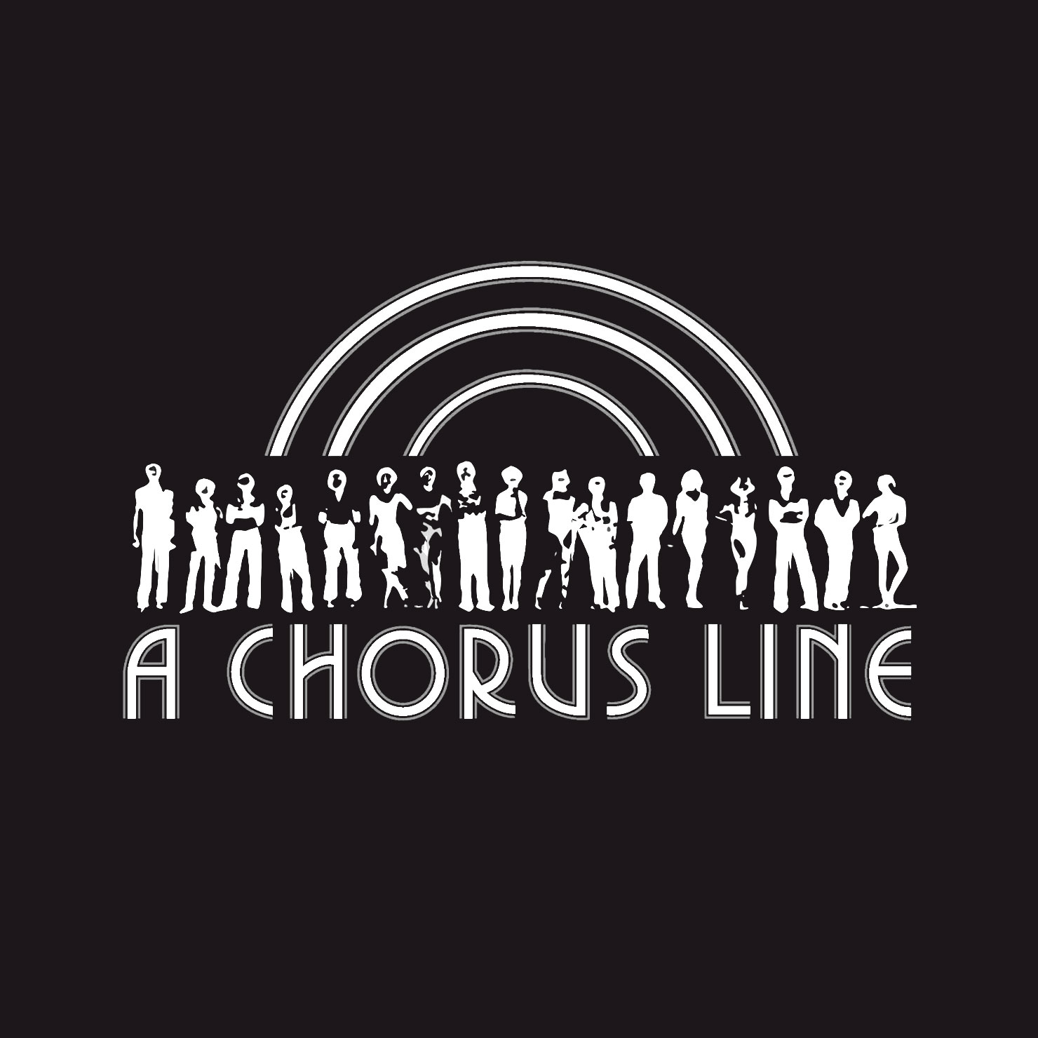
Our breakdown of
By: Sebastian Recht, Elisheva Schofield, Kareen Singh, Marwa Soussi, Dylan Tchedji, Lekovic Teoh, Joshua Thomas, & Emily Wu

Slide 2
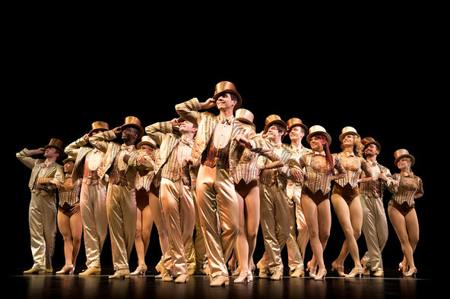
What’s Our Thesis?
A Chorus Line reflects the issue of unemployment regarding gender, class, and identity throughout 1975.

Slide 3
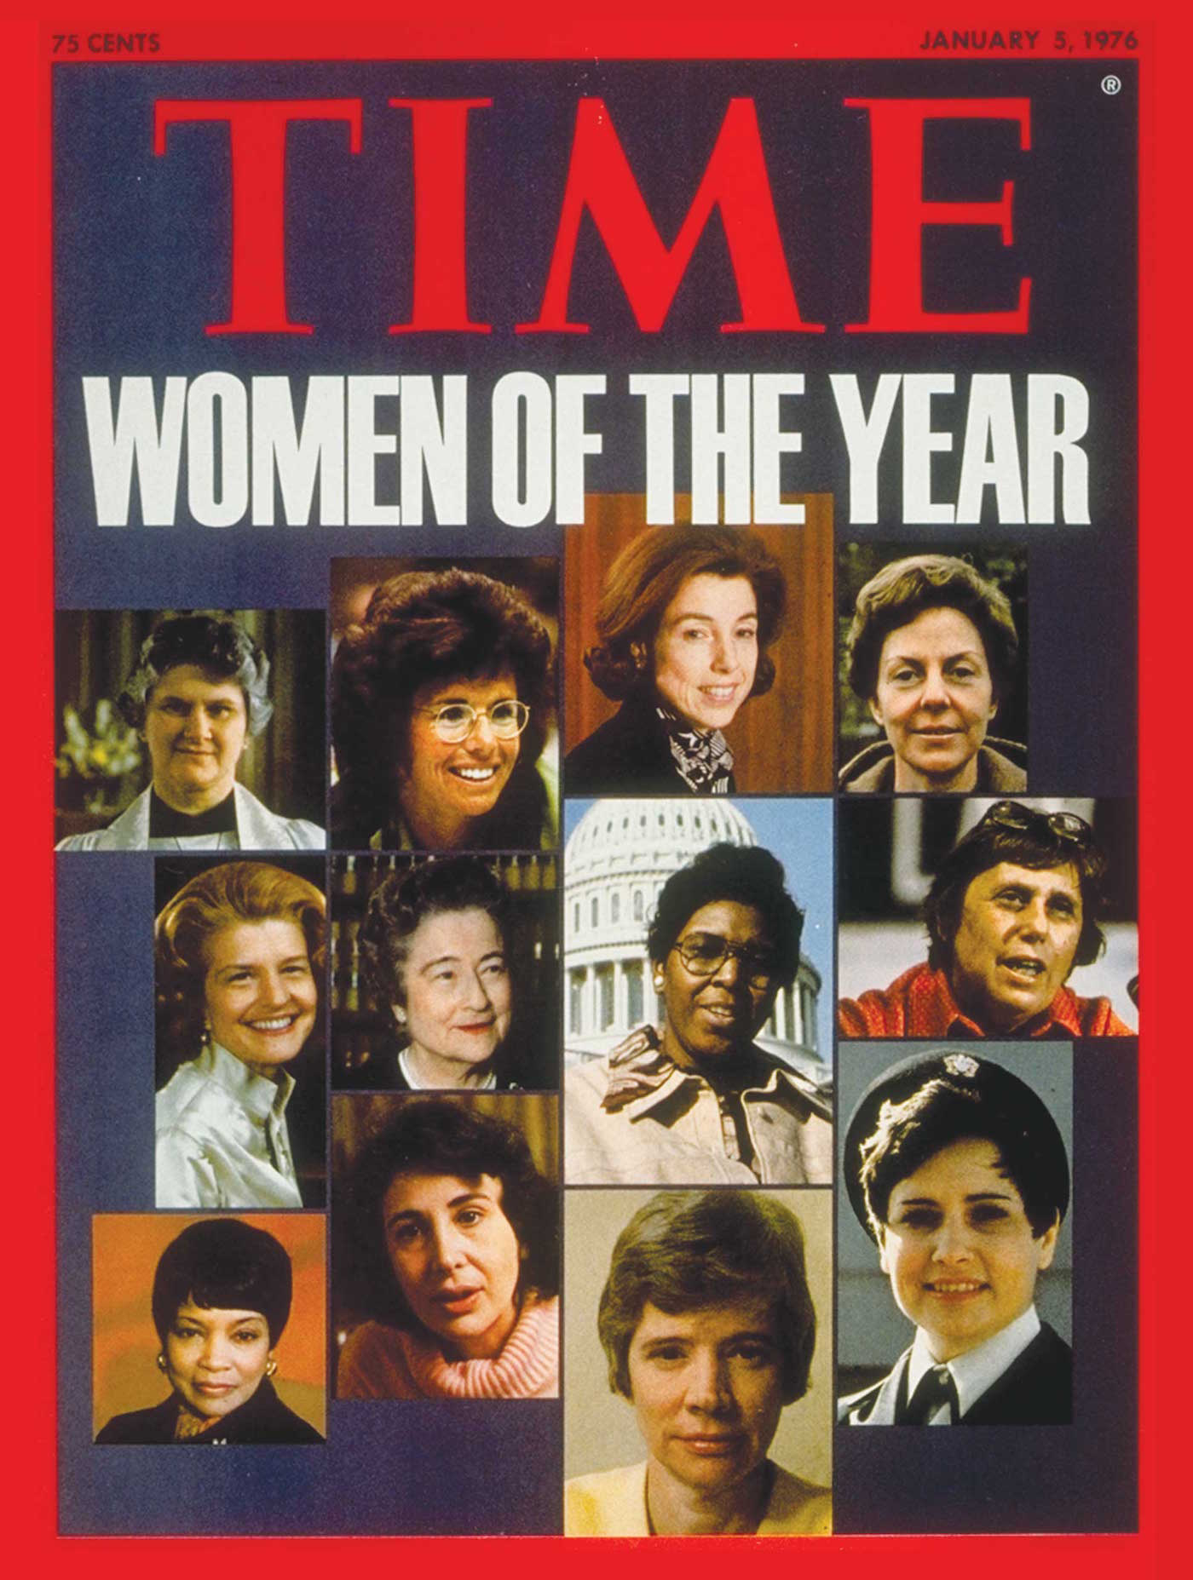
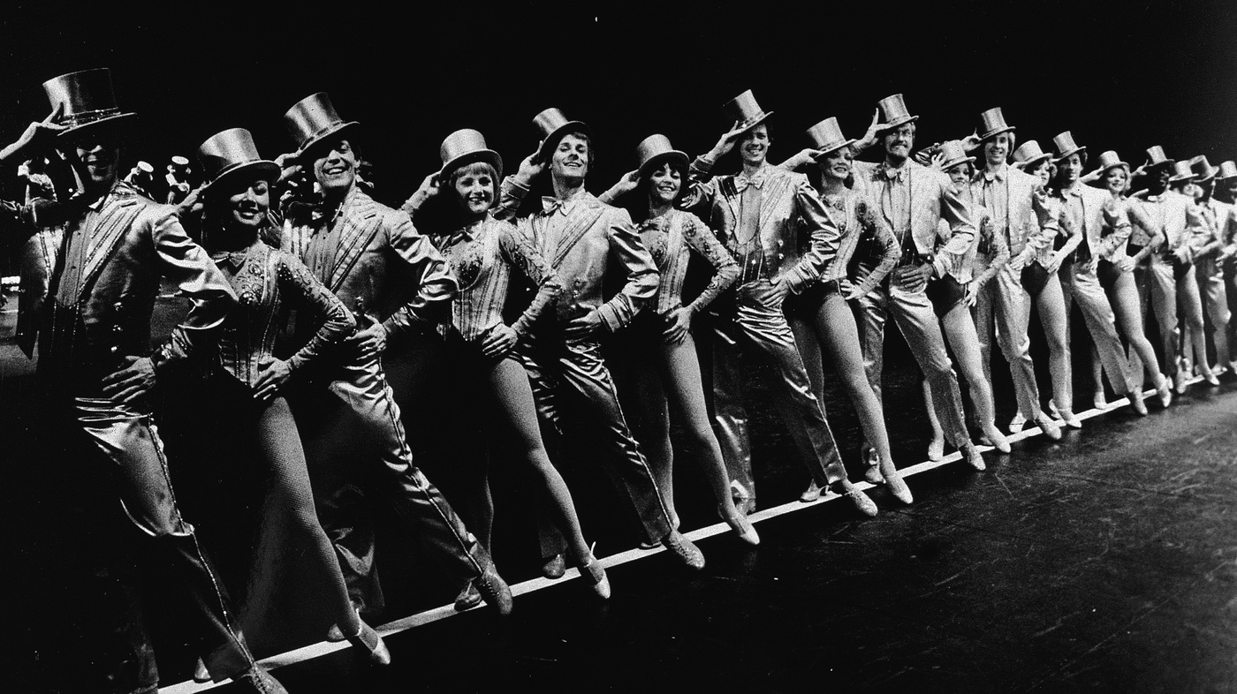
About the year -- Elisheva Schofield --
The atmosphere of 1975 was one of activism for the individual. The women’s liberation movement and the gay liberation movement are two examples of the movements that were going on in the 1970’s. The feminists were trying to get the ERA passed, the Stonewall riots were just a few years earlier, as well as the Civil Rights Act that was only passed 9 years before A Chorus Line’ debut. But amidst all this, the unemployment rate was at a record high. Dancers were no exception.

Slide 4
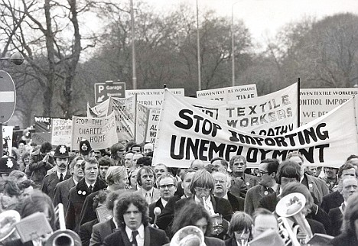
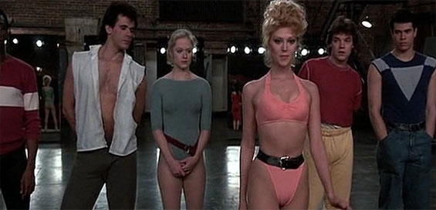
Sexuality & Unemployment Rate in the 1970’s -- Dylan Tchedji --
Sexuality
Now as for sexuality. In the 1970’s there was the women’s liberation movement, in which women and girls who had been long told they were the inferior sex finally took the courts and voting booths to assert their quality.
Unemployment Rate
Unemployment rate by year is the percent of unemployed in the labor force. It tracks the health of the country’s economy. Around the year of 1975, the unemployment rate was really high and the minimum percentage was 10.8%

Slide 5
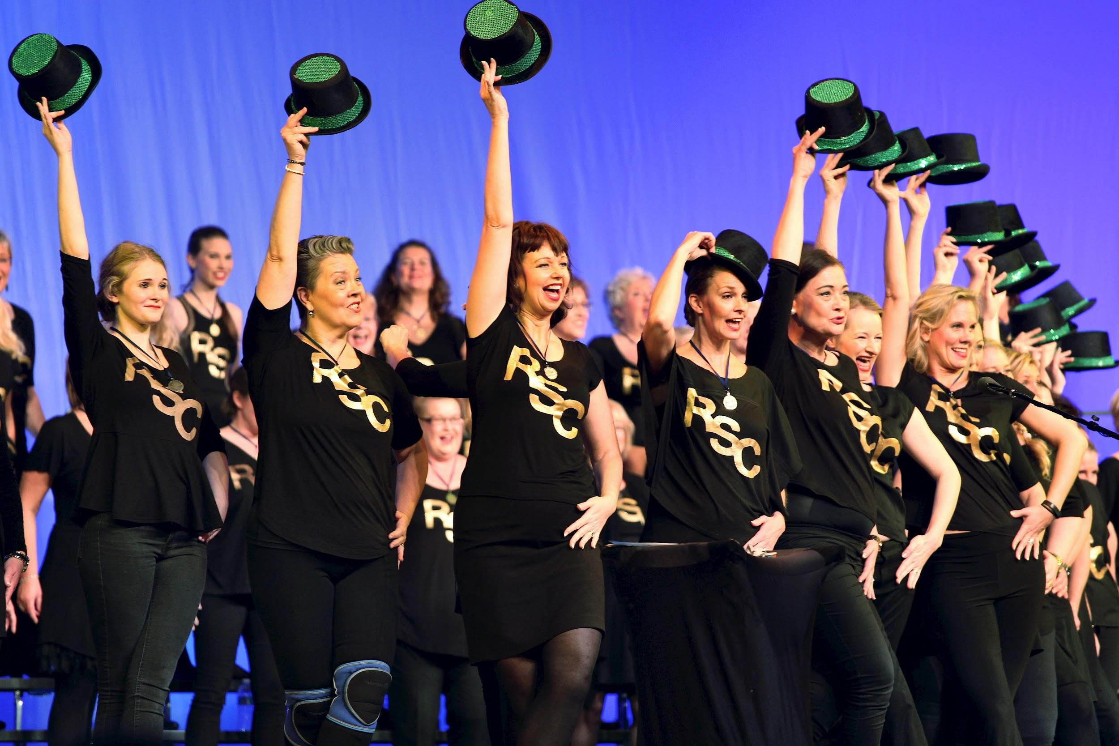
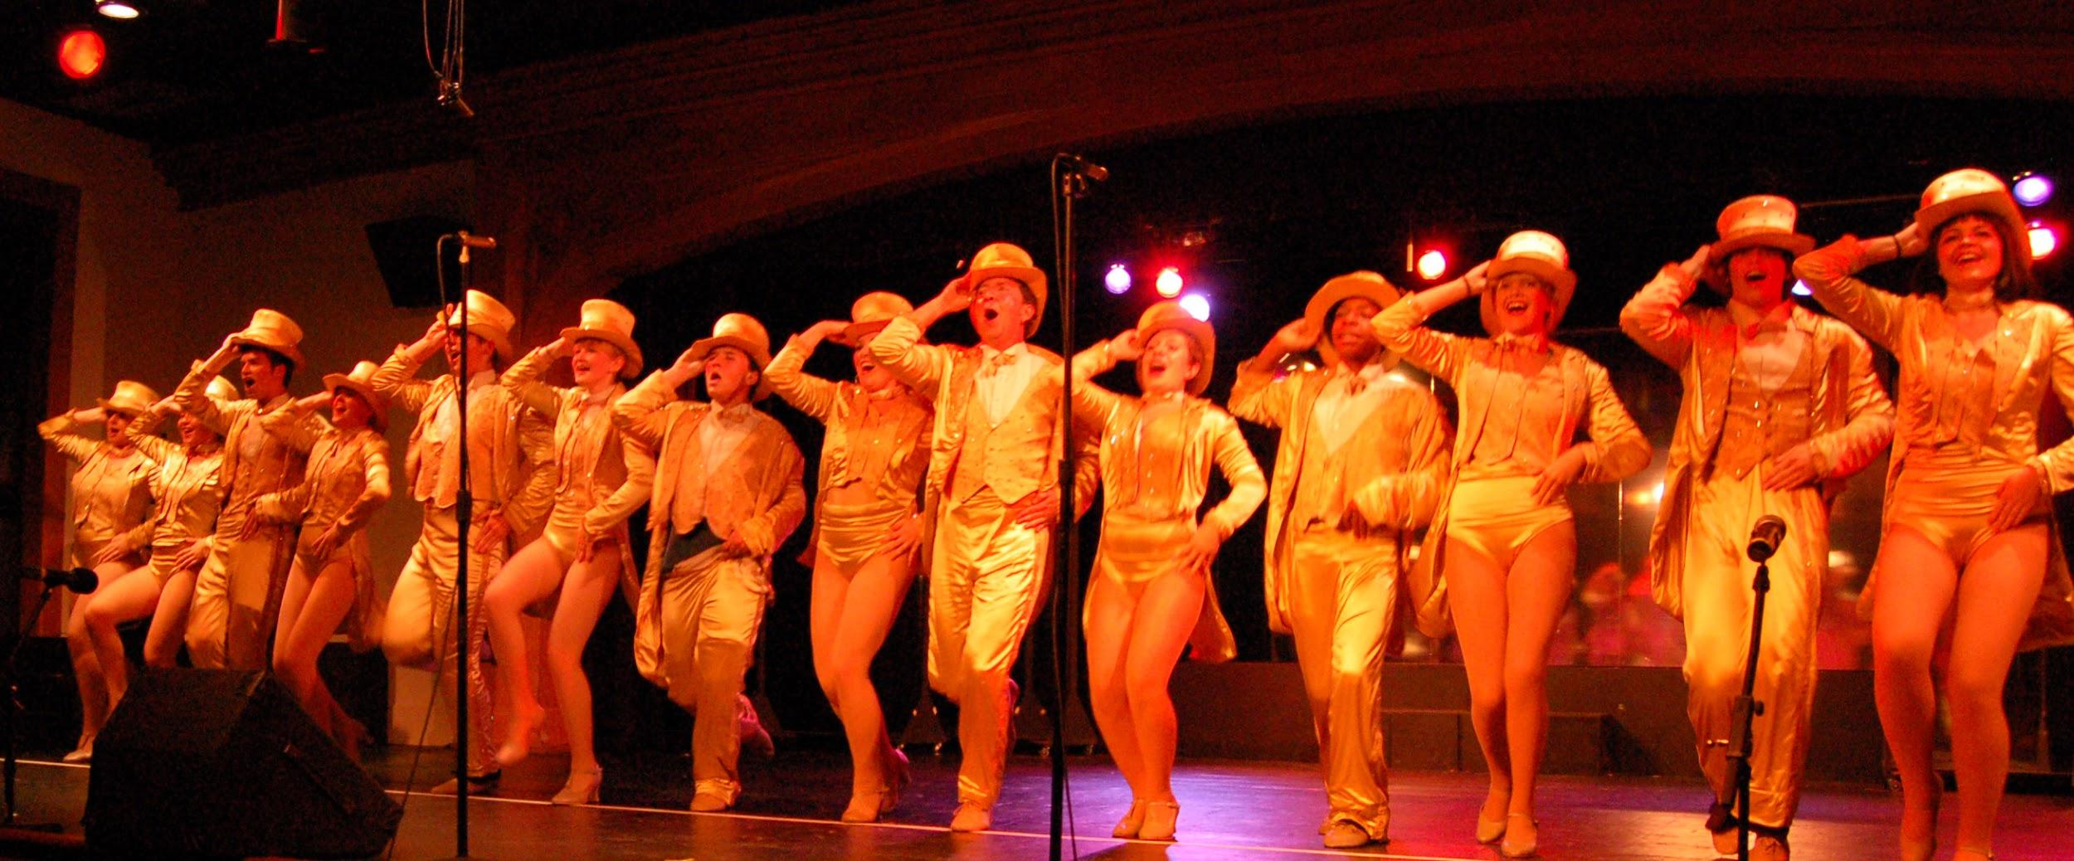
Gender
-- Emily Wu --
Gender had played a major role in A Chorus Line since it’s in the 1970’s. People still choose men over women during that time. During the time of A Chorus Line women had to be a certain way to be hired. They would judge you as a whole. For example like; if you had a good body shape, were you pretty, your age, and more. During the 1970’s, job was a problem for women. During that time women are more defined as housewives than individuals, and when it comes to hiring women, men’s might think women’s don’t suit the jobs. According to “The great white way” Hoffman talked about Val. She is one of the dancers who auditioned for the musical. She was the one who did plastic surgery to become pretty. According to “About Face” Marx also talked about how the average rate of south koreans overdone plastic surgeries to look the way how they wanted to. This shows us that only pretty girls were able to find a job, and men can be whoever they want. It also shows that the society outweighs men than women. Men is still like the whole part of society and women is still unknown.

Slide 6
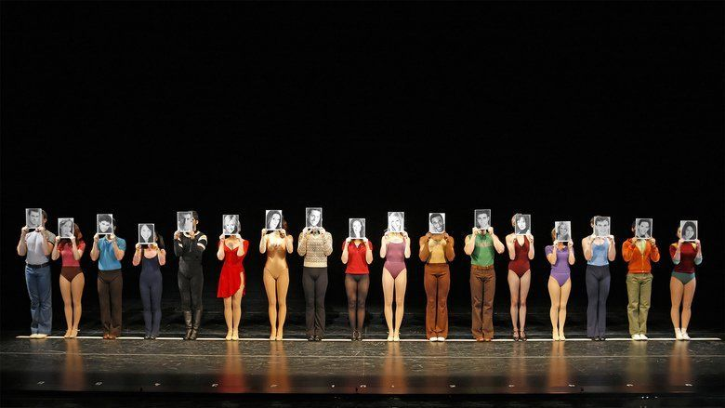
Theme: Identity
-- Kareen Singh --
Identity is a large idea shown throughout the auditions of this film. Through race, gender, sexuality and even class, A Chorus line demonstrates how identity is such an important factor for everyone. The auditions include short introductions by each performer, basics such as age, background and ethnicity. Following their “first impression” speeches, the director follows up with deeper questions to unravel the true identity of each dancer from their inner selves. The rest of the film includes each auditioner breaking down who they are underneath their skin.

Slide 7
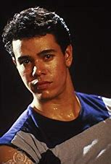
Sexuality
-- Joshua Thomas --
So many events occurred during this time that dealt with the homosexual lifestyle. June 28, 1969 marks the day of the Stonewall riots in which gays
Protested against the police force with words and with violence, simply for
Equal treatment. The Seventies marked a decade where the musical theatre
came to embrace all-star talents like Paul and Greg in ‘A Chorus Line’ with open arms. In fact, musicals like, ‘Lovers: A musical that proves its no longer Sad to be Gay,’ and ‘Let My People Come,’ and ‘Fascination’ were all musicals based on the relationships
of gay lovers. ‘A Chorus Line was significant because rather than fight the cause
Michael Bennet supported it and gave these two cast members no greater or
lesser of an opportunity.

Slide 8
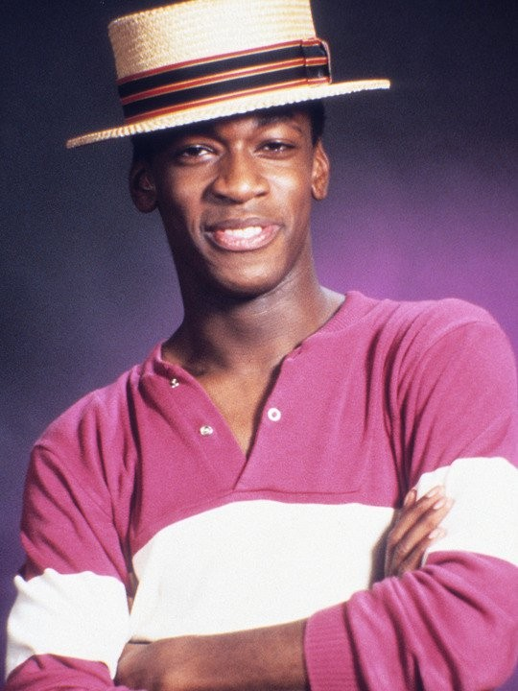
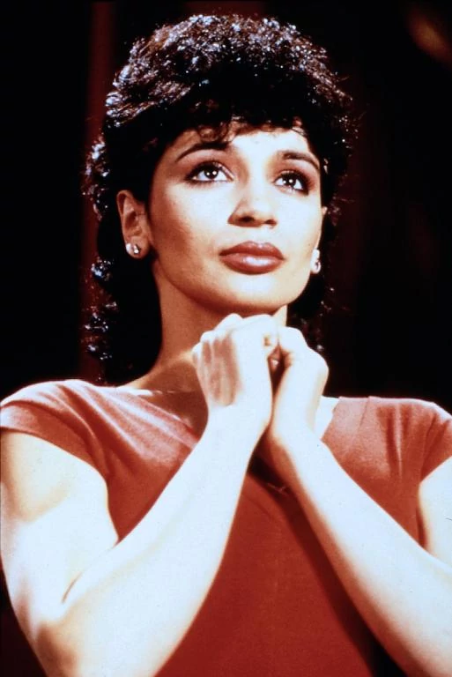
Ethnicity -- Joshua Thomas --
Usually when we all think of racial discrimination in America we can go directly to the history of slavery and the injustice that African Americans endured. However, we cannot overlook the fact that there, for a long time, has been immigrants coming into America who have always been overlooked, paid less, threatened and demeaned. According to Warren Hoffman, writer of “Great White Way,” Richie understood that most employers at those times were “not colorblind” as Zach was depicted in this musical. In actuality many Americans were ignorant to the fact that we all human beings with a different. ‘A Chorus Line’ did not actually deal with racial discrimination because the writers wanted to show a world where that simply didn’t exist.
In addition, the question that an audience may ask pose is, Is it ignorant to act as if these prejudices don’t exist? Connie was Asian and shorter than the rest of the cast , Richie, although one of the most talented was black and would stand out, while Paul and Diana were Hispanic. However, the theme of this piece is for the audience to imagine a world where they would not see the difference between a Black, White, Asian, or Hispanic dancer, but a world where they would simply see the dancers as people with a talent.
“I’M
BLACK”

Slide 9
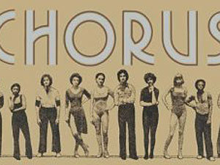
Class -- Marwa Soussi --
In A Chorus Line, class isn’t depicted as much as other musicals that came before and after A Chorus Line. It is simply about a musical in which the dancers are looking to become part of something bigger; something to help out in their lives and allow the audience to view what is happening. If there is no class in a musical, then that makes it easier for the audience to connect with the actors, dancers, etc. because not everybody is rich and not everybody is poor, but if a musical shows that everyone is equal it will help make the message clear to others.

Slide 10
-- Lekovic Teoh --
Socioeconomic Commentary
Peak of recession at 1975.
Capitalist corporations take advantage of high unemployment.
Want maximize profits. How?
High demand for jobs, low supply of positions
Make workers compete for low paying positions.
Make every job simple so workers become a single unit in a giant machine
Taylorism: Industrial Capitalist philosophy that society has 3 classes:
Scientists, managers, and workers.
Need to know the personality of individual workers in order to control any individual

Slide 11
Socioeconomic Commentary Cont.
-- Lekovic Teoh --
Taylorism is common theme throughout A Chorus Line
Zach is the manager, dancers are the workers.
The dancers are interviewed about their personal lives, past experiences, in order to figure out how every individual behaves and pick those with the personalities that are best to work in the chorus line
Both the idea of taylorism and a chorus line juxtapose individuality and uniformity. One can’t live without the other.

Slide 12
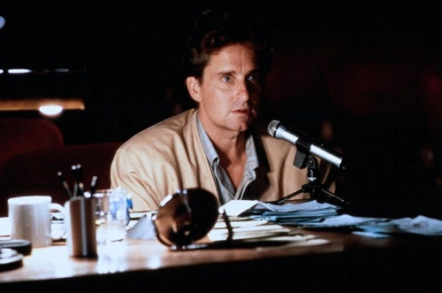
-- Lekovic Teoh --
Quotes Reflecting Taylorism
“Now - this is important! I want to see Unison Dancing. Every head, arm, body angle, exactly the same. You must blend. This is one of those numbers where you back the star - you’re her frame. I don’t want anybody to pull my eye. Now, let's review it.”
- Zach, A Chorus Line
“I need people that look terrific together - and that can work together as a group. Now, I have your pictures and resumes, I know what shows you’ve been in - but that’s not gonna help me. And I don’t want to give you just a few lines to read. I think it would be better if I knew something about you - about your personalities.”
- Zach, A Chorus Line

Slide 13
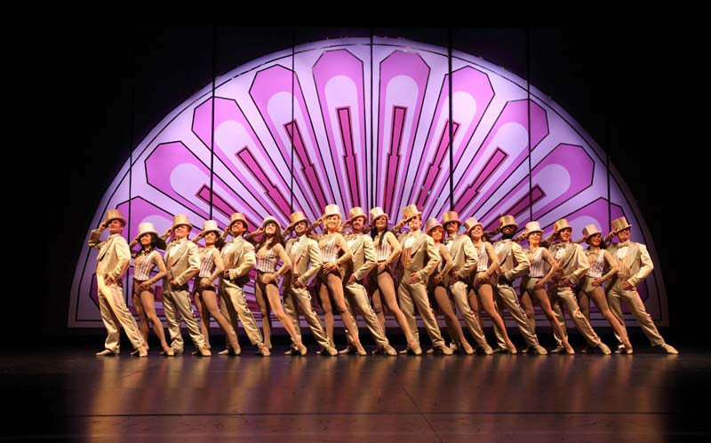
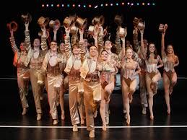
Song/Scene Analysis
-- Sebastian Recht --
One (Finale)
Throughout the musical, there is a strong irony regarding the identity of the dancers in the chorus line. In the beginning, each dancer was encouraged by Zach to emerge as an individual with emotional context given through respective backgrounds. However, during the finale, the dancers emerged as an anonymous line of dancers and their identities were masked behind their ostentatious costumes. Paradoxically...

